Slide 1
Team Panda
Peiyang Chang & Yanjie Ning

Slide 2
Topic
Process of car sales
Customer needs information
Customer needs to view cars and ask question
Customer decides to buy car
Customer makes a payment
If car needs maintenance for their car

Slide 3
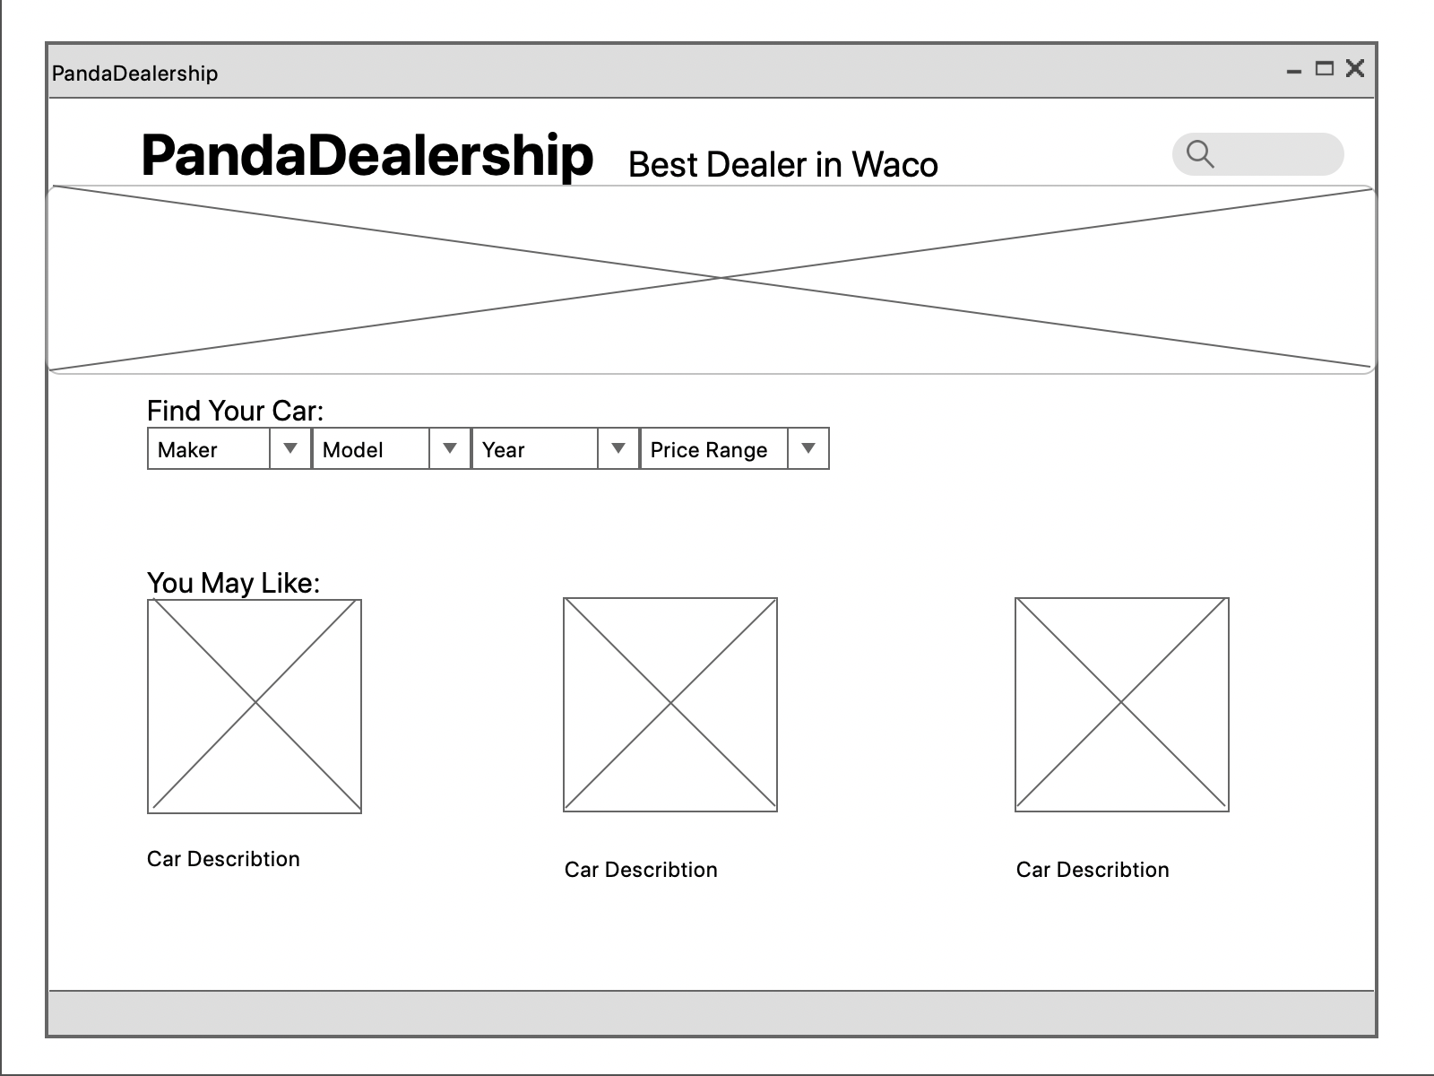
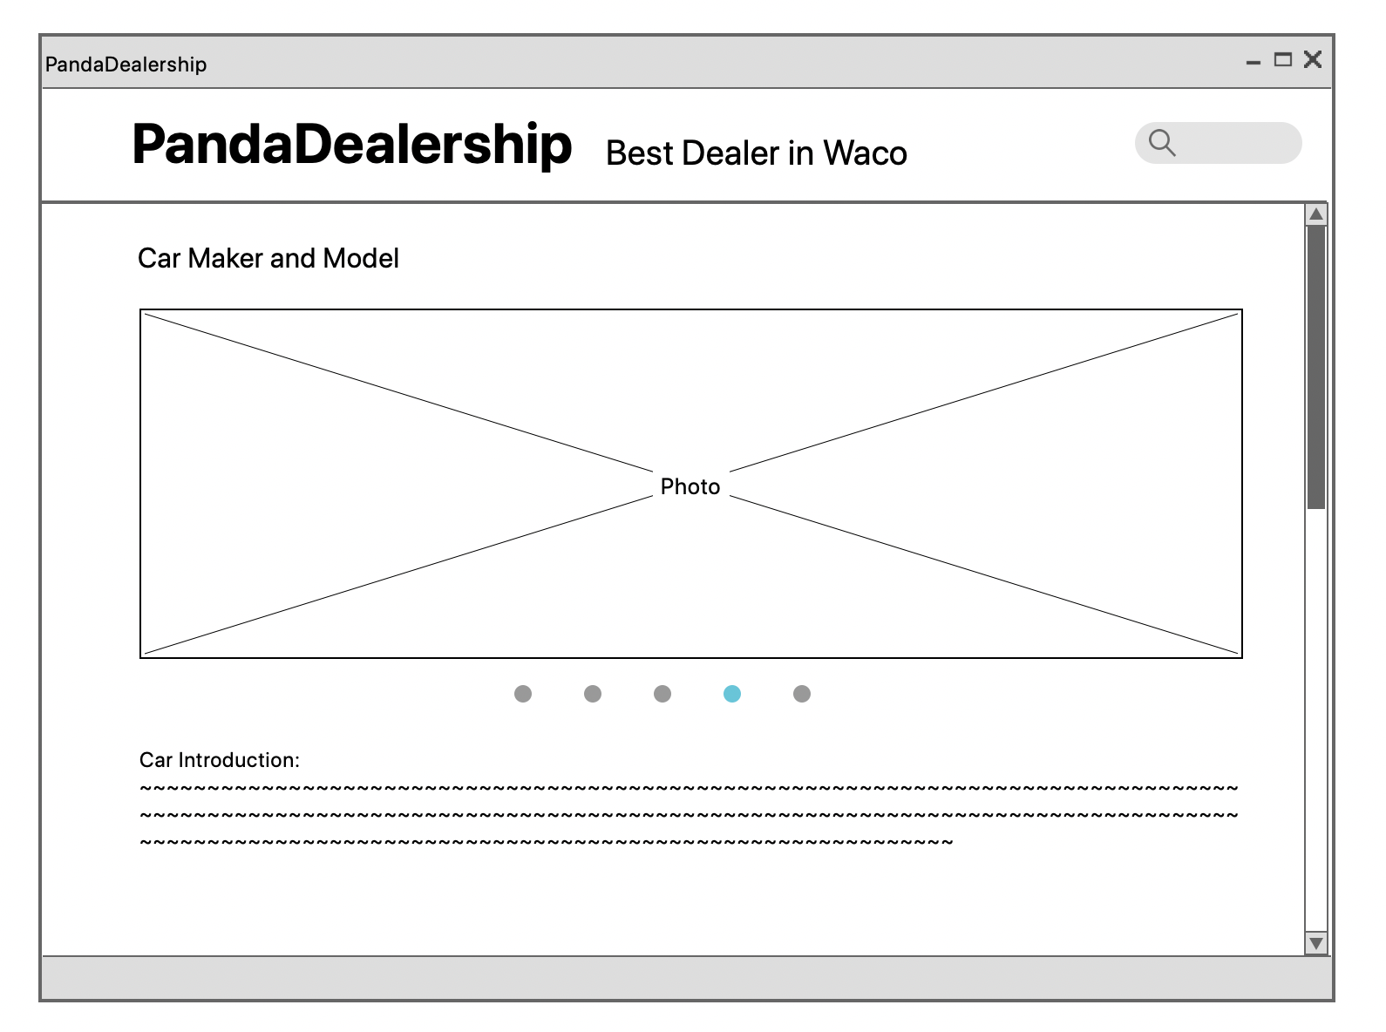
User Interface Layout

Slide 4
Use Case
Get Information
View Car
Search Car
Test Car
Consultation Service
Choose Car
Make Payment
Leave the store
*Maintenance

Slide 5
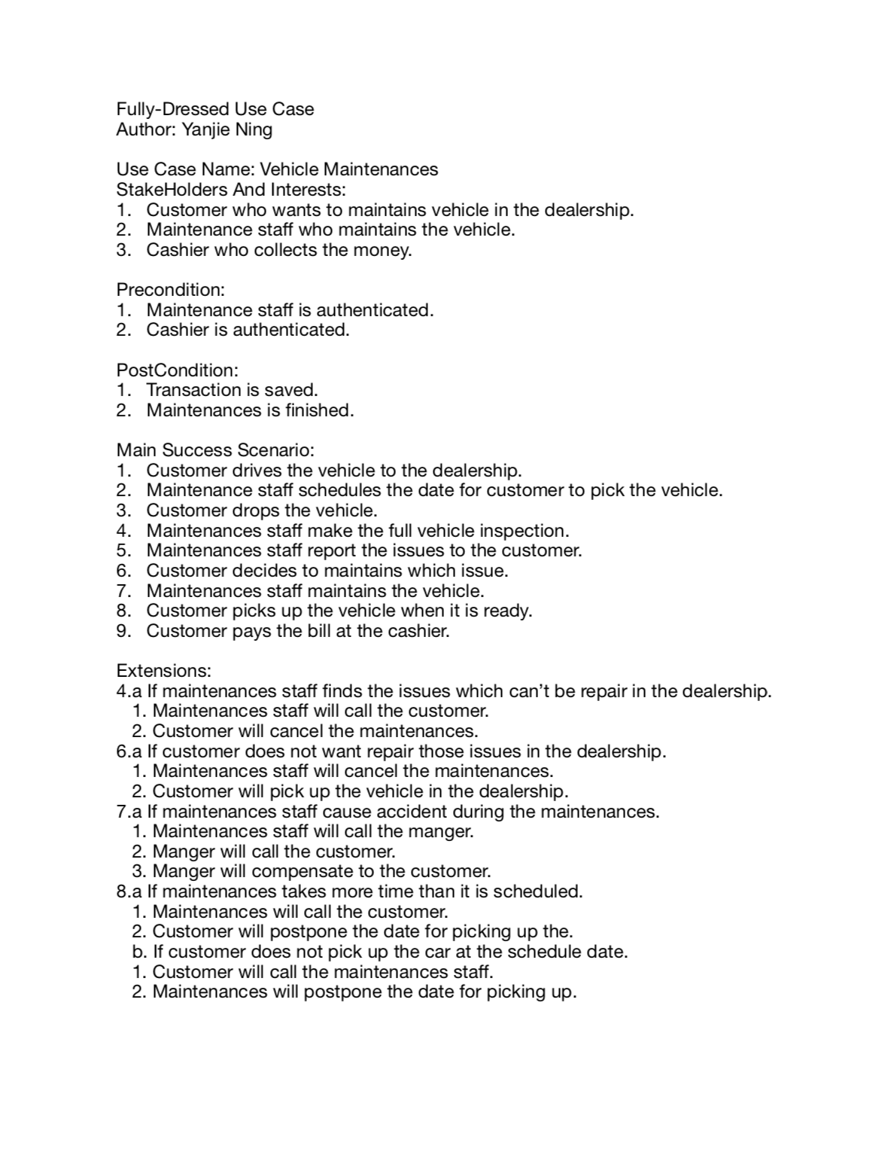
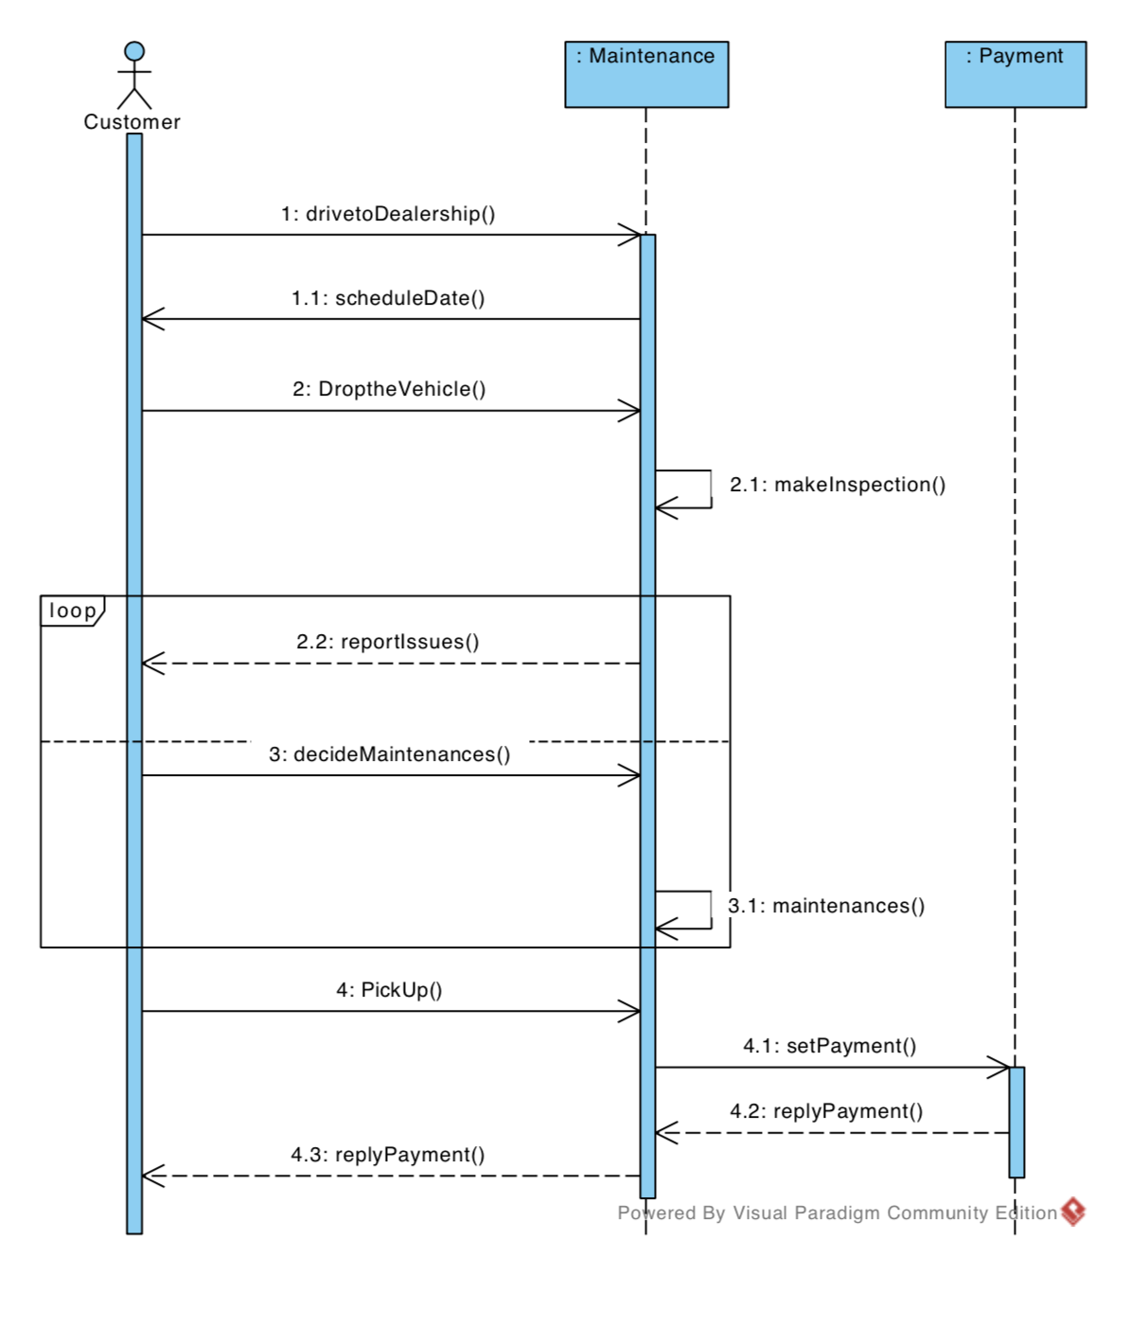

Slide 6
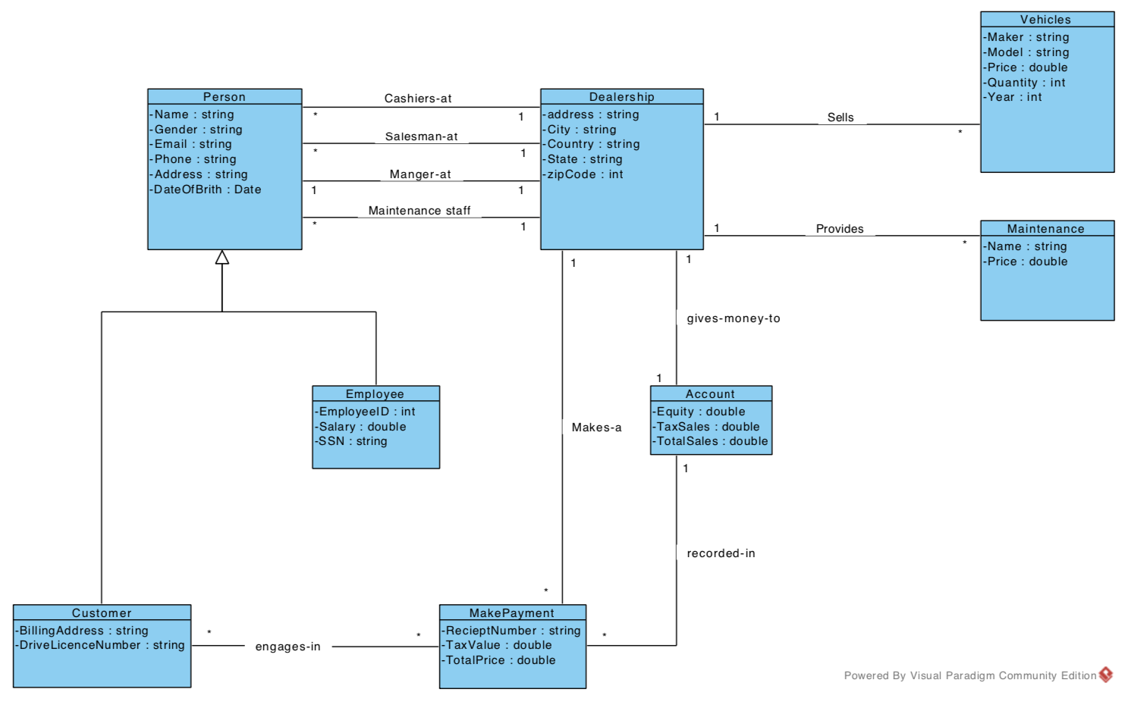
Domain Model

Slide 7
In Conclusion
More type of cars, more choices
Lots of cars in the stock

